Slide 1

A PROJECT MID-TERM PRESENTATION ON
“Breast Cancer Detection Using Logistic Regression”
PRESENTED BY
BISHESH NEUPANE (24367/076)
DEV RAJ BASNET(24370/076)
RAM TIMILSINA(24383/076)
SUPERVISED BY
SAGAR RANA MAGAR
LECTURER, SWASTIK COLLEGE
DECEMBER, 2023

Slide 2
Title Slide | 1
Introduction | 3
Problem Statement | 4
Objectives | 5
Scope | 6
Limitations | 7
Literature Review | 8
Tools Used | 9
Methodology | 10-15
Functional Requirement | 16-19
Result | 20
References | 21-22
Presentation
Outline

Slide 3
Introduction
Breast Cancer !!!
Breast Cancer is cancer that develop from breast tissues.
Breast Cancer is a diseases in which malignant (cancer) cells from in the tissues of breast.
For smarter solution this project explores application of data sciences for breast cancer detection.
Uses different attributes of chest x-ray report to detect breast cancer.
Can be used for breast cancer prediction whether the tumor is benign or malignant tumor.

Slide 4
Problem Statement
Late identification – Delayed recognition of conditions.
Manual errors- Human mistakes.
Medical complexity challenging detection- Variability in health information.
Computer-aided diagnosis using Logistic Regression analysis for enhanced cancer detection accuracy.

Slide 5
Objectives
The main objective of this project is to develop a Breast cancer detection system using logistic Regression.

Slide 6
Scope
Focuses on creating a complete system to detect breast cancer.
Can be used in medical centers and hospitals for finding breast cancer result.
Can be integrated in telemedicine platforms to provide recommendations for future evaluation.
The project aims to improve the tools and methods used to diagnose breast cancer.

Slide 7
Limitations
Can’t give the result by taking X-ray report image as input.
There is a risk of overfitting. ( the model performs well on training data but fails to generalized to new, unseen data.)

Slide 8
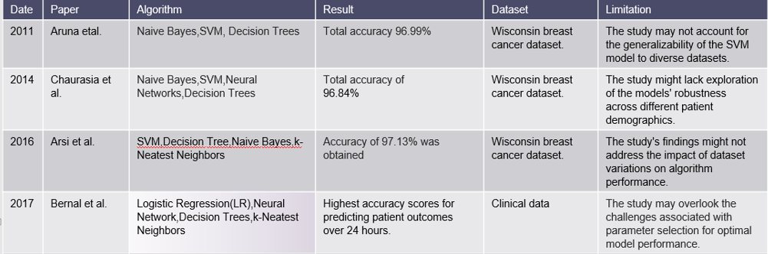
Literature Review

Slide 9






Tools Used
Python libraries such as pandas, numpy,matplotlib etc .
Pandas is used for data manipulation and analysis.
Numpy is used for mathmetical computation .
Matplotlib is used for data analysis.

Slide 10
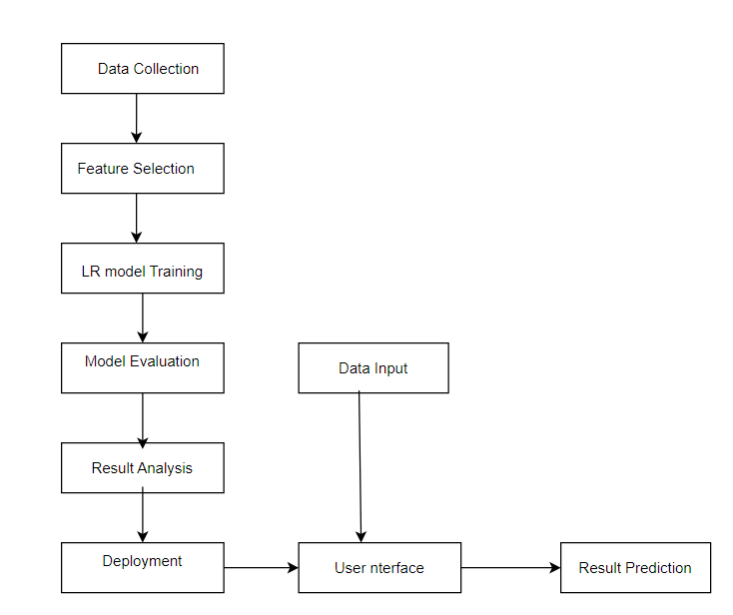
Methodology

Slide 11
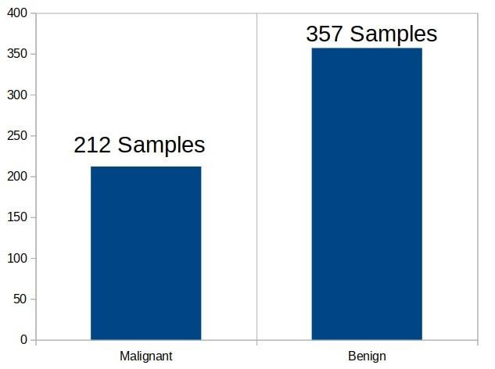
Methodology
Dataset collection
Publicly Available Dataset from kaggle.
Attributes
Diagnosis : The diagnosis of breast tissues (1= malignant, 0=benign)
Radius_mean : Mean of the distance from center to points of perimeter.
Texture_mean : standard deviation of gray-scale values.
Smoothness_mean : mean of the local variation in radius lengths.

Slide 12
Data preprocessing
Handle missing data i.e impute or remove missing values.

Slide 13
Applying the regression models on dataset Algorithm implemented
Logistic Regression
Supervised learning algorithm which is used to solve the classification problems.
Works with the categorical variable such as 0 or 1, Yes or No, True or False, Spam or not spam, etc.
Uses sigmoid function or logistic function which is a complex cost function.

Slide 14
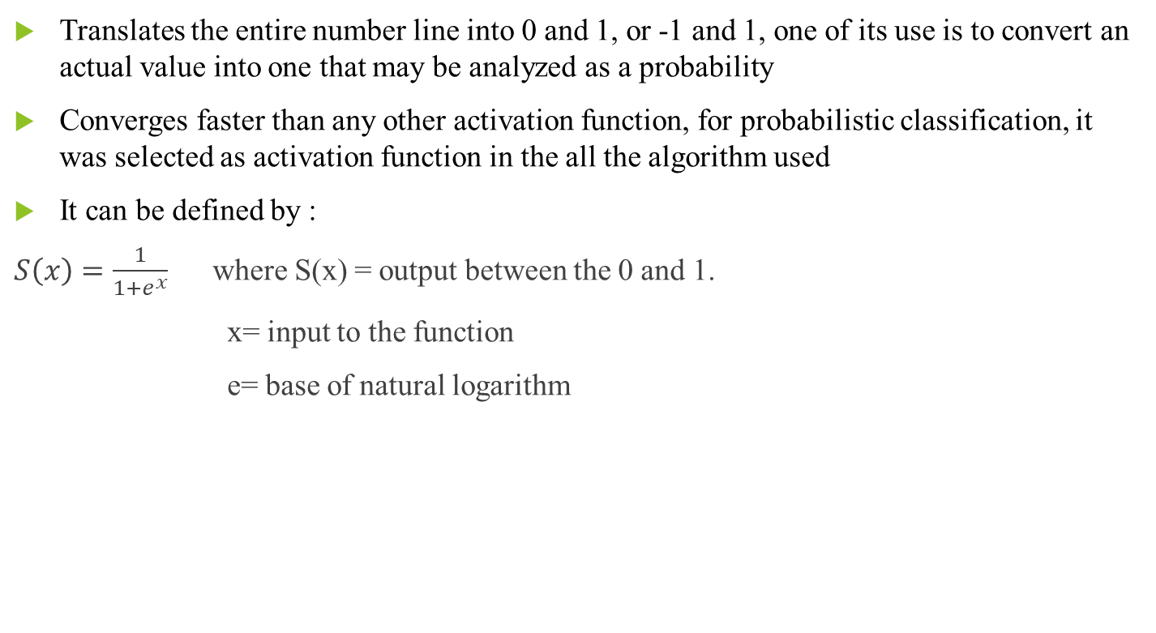
Sigmoid Function
Translates the entire number line into 0 and 1, or -1 and 1, one of its use is to convert an actual value into one that may be analyzed as a probability
Converges faster than any other activation function, for probabilistic classification, it was selected as activation function in the all the algorithm used
It can be defined by :
$S\left(x\right)=\frac{1}{1+e^{x}}$ where S(x) = output between the 0 and 1.
x= input to the function
e= base of natural logarithm

Slide 15
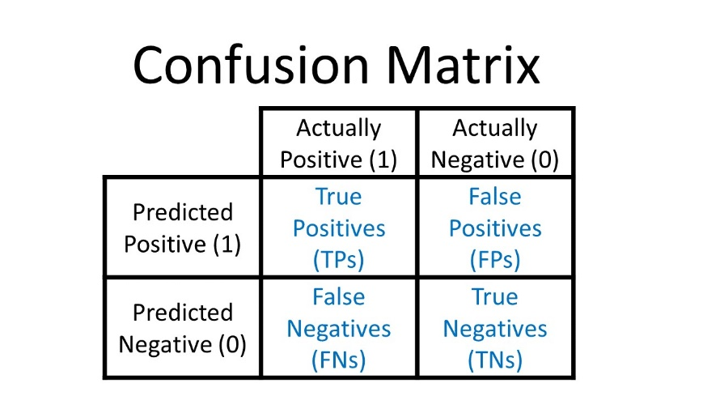
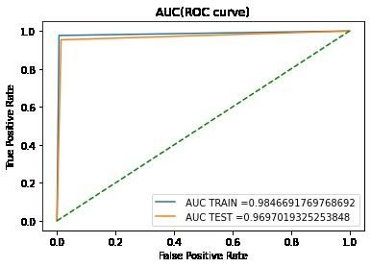
Evaluation criteria
Confusion matrix
LR AUC Curve

Slide 16
Classification Report
This report is used to measure the quality of predictions from a classification algorithm.
Four way to check the prediction are rights or wrong.
True positive : When a case was positive and predicted positive.
True Negative : When a case was negative and predicted negative.
False Negative : When a case was positive but predicted negative.
False positive : When a case was negative but predicted positive.
LR AUC Curve
The area under the receiver operating characteristic (ROC) curve for a logistic regression model represents the probability that the model will rank a randomly chosen positive instance higher than a randomly chosen negative instance.

Slide 17
Functional Requirement
Input Data: The System should provide the user/admin to input the data that later feed to algorithm.
Model: A Logistic Regression (LR) model should be utilized and trained on the kaggle dataset. The model should take the data as input and predicts result on the basis of trained dataset.
User interface:There should be user interface to manage user interactions, including data input.
Predict: Once data is given, the model should process the information and provide a prediction based on the trained dataset. The prediction should be displayed on the webpage to update the UI with the result.
View Result: Users should be able to view the results through the system, showcasing predictions of tumor types as either benign or malignant.
Add dataset: In this system, administrators should have the ability to add datasets, train them, and perform testing as needed.

Slide 18
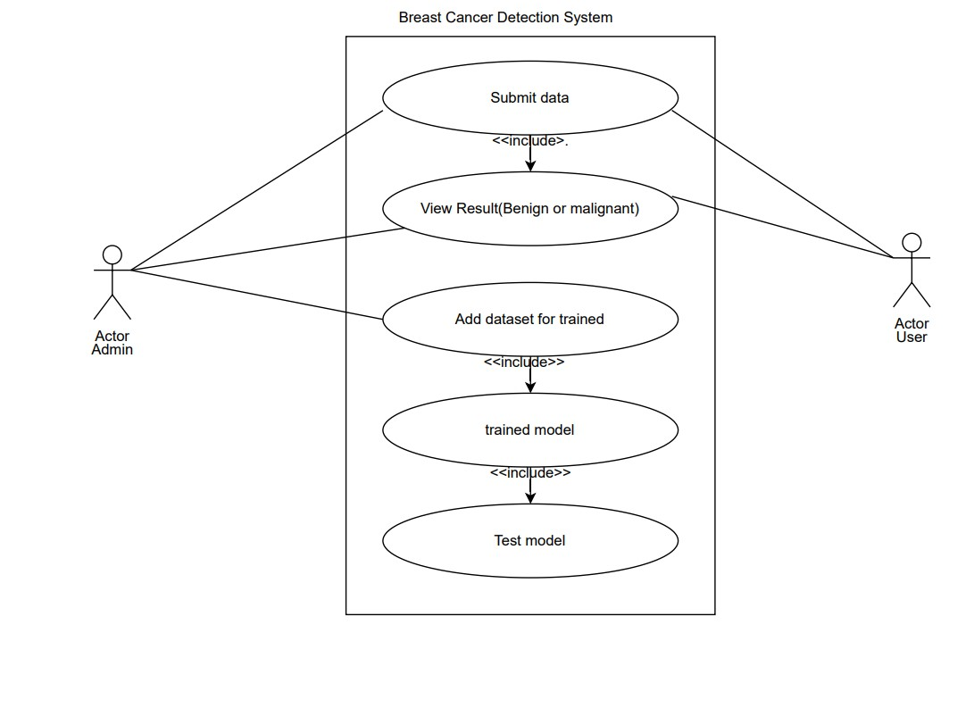
Functional Requirement Use Case Diagram

Slide 19
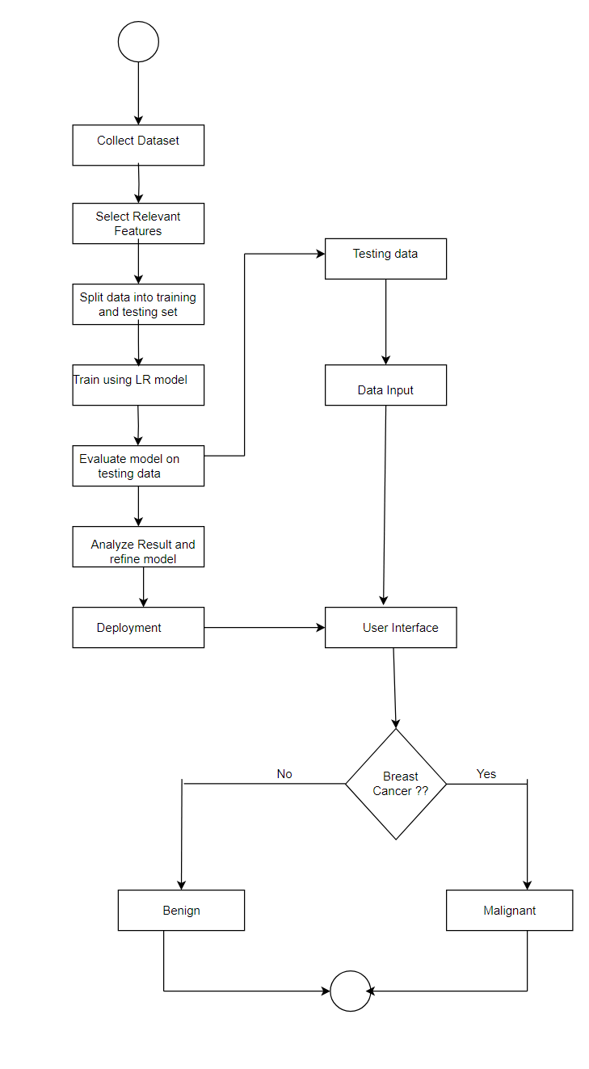
Functional Requirement Activity Diagram

Slide 20
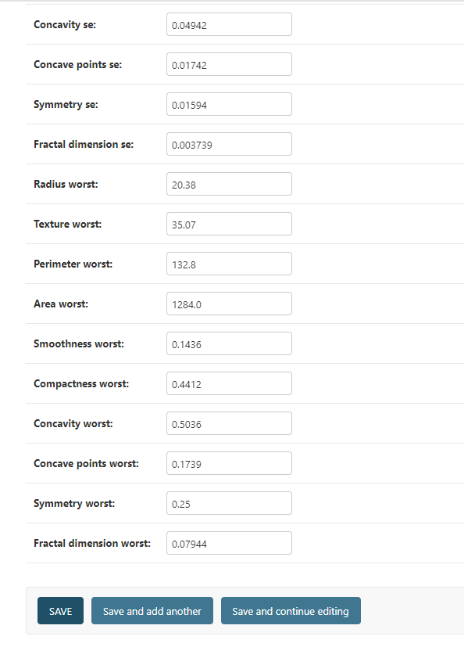
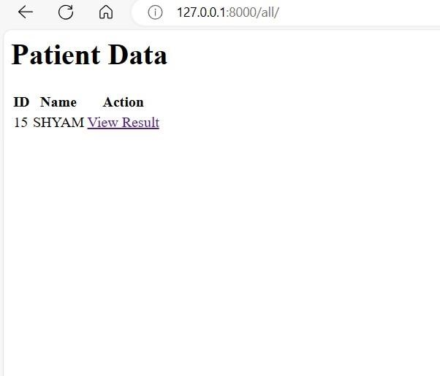
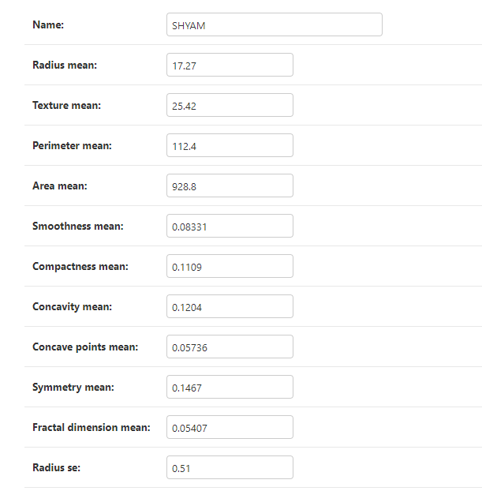
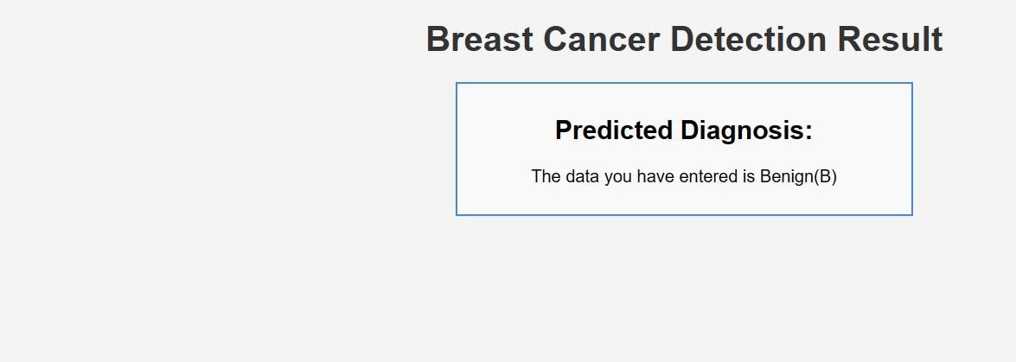
RESULT

Slide 21
References
1. Aruna, S.; Rajagopalan, S.; Nandakishore, L. Knowledge based analysis of various statistical tools in detecting breast cancer. Comput. Sci. Inf. Technol. 2011, 2, 37–45.
2. Chaurasia, V.; Pal, S. Data mining techniques: To predict and resolve breast cancer survivability. Int. J.Comput. Sci. Mob. Comput. 2014, 3, 10–22.
3. Asri, H.; Mousannif, H.; Al Moatassime, H.; Noel, T. Using machine learning algorithms for breast cancer risk prediction and diagnosis. Procedia Comput. Sci. 2016, 83, 1064–1069.
4. Bernal, J.L.; Cummins, S.; Gasparrini, A. Interrupted time series regression for the evaluation of public health interventions: A tutorial. Int. J. Epidemiol. 2017, 46, 348–355.

Slide 22
Thank You
Any Question ?????

